Slide 1

Large Language Models (LLMs) Workshop
Introduction and Hands-On Examples

Slide 2
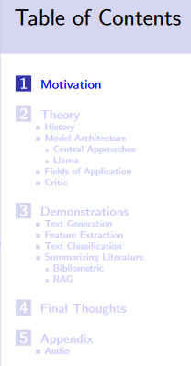

Workshop procedure Too much too little time >> 100 slides
~ first 1 – 1,5 hours: theory
rest “3. Demonstrations”
Relatively little interaction, more in the form of a monologue
Set up working groups regarding X if desired?

Slide 3


Who am I?
EDUCATIONAL TRAINING
Sep 2015 – Sep 2018 Applied Statistics (M.Sc.), University of Göttingen
Sep 2012 – July 2015 Psychology (B.Sc.), Université de Fribourg (CH)
PROFESSIONAL TRAINING
Since April 2024 PostDoc Project in the DFG Research Training Group “Statistical Modeling in Psychology”, primary advisor Prof. Kiesel (University of Freiburg)
October 2020 – March 2024 PhD Project in the DFG Research Training Group “Statistical Modeling in Psychology”, primary advisor Prof. Kiesel (University of Freiburg)
Since Jan 2020 freelancer: coach for data analysis (supervision of bachelor, master and doctoral theses), private tuition on statistics

Slide 4
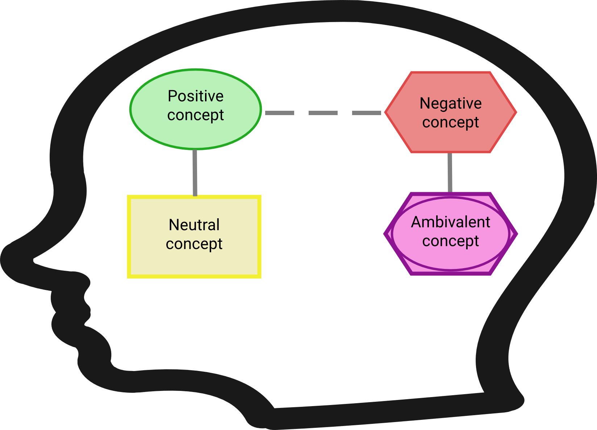
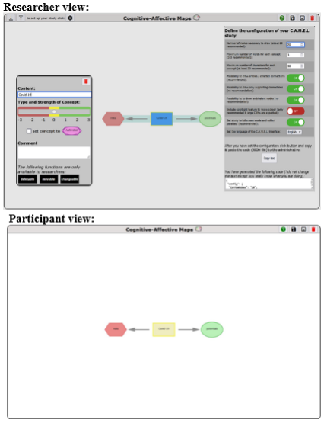
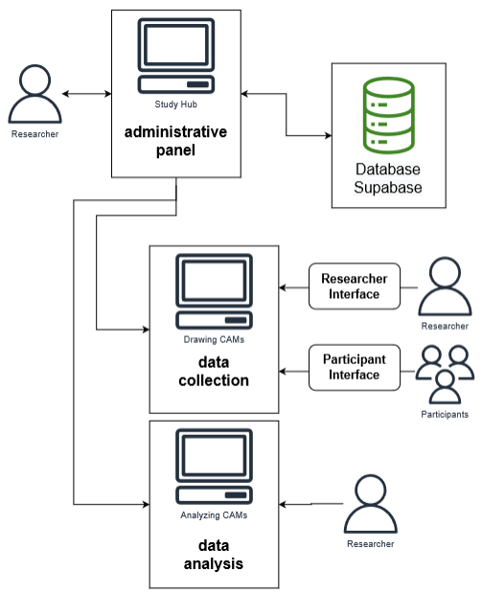
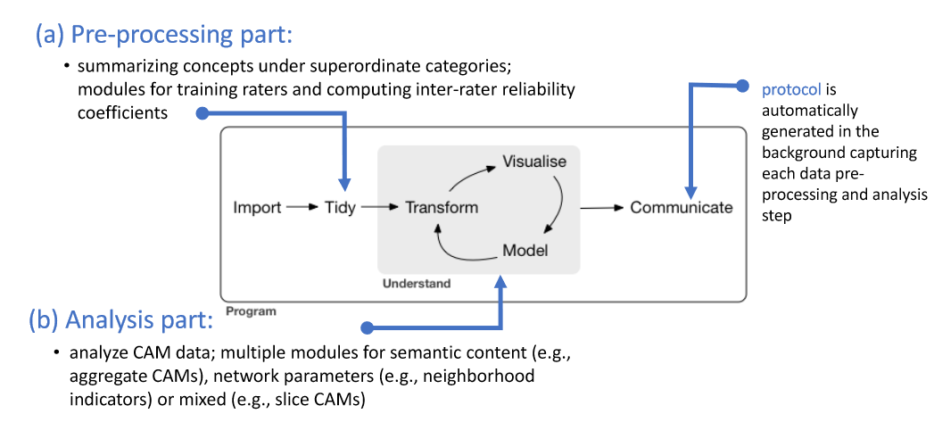
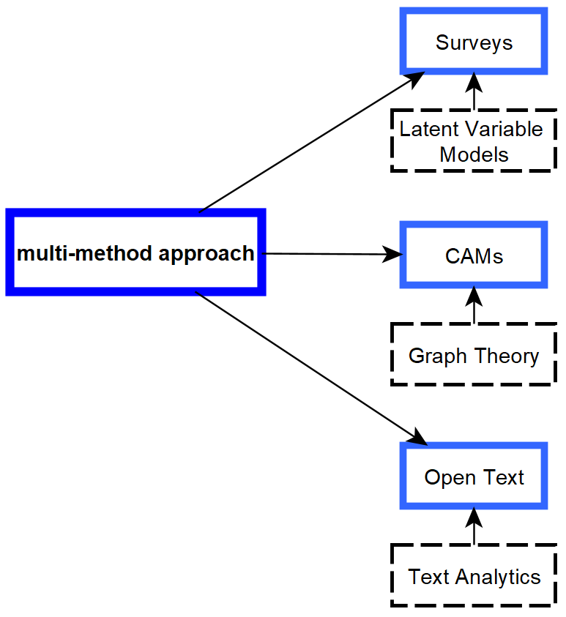
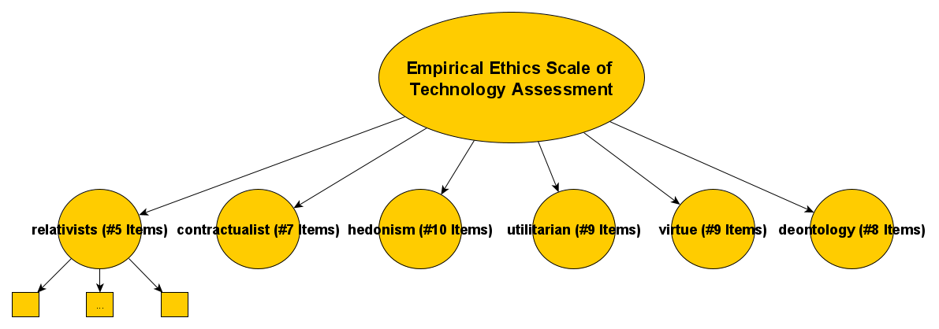
My research <-> LLMs
Semantic Networks: Cognitive-Affective Maps extended logic: Proposing Tools to Collect and Analyze Attitudes and Belief Systems
Empirical Ethics: Development and Validation of an Empirical Ethics Scale for Technology Assessment - Challenges and Perspectives for a Real Time Ethics for Emerging Technologies
Prospective Technology Assessment: Propose methodologies to investigate (ethical) concerns of technologies at an early development stage.

Slide 5
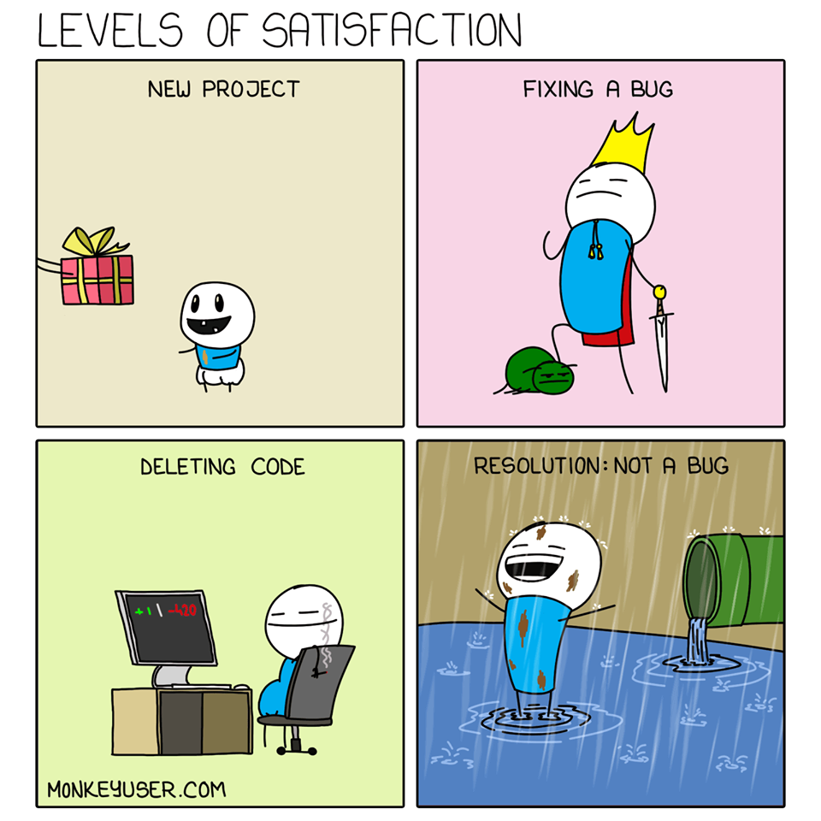

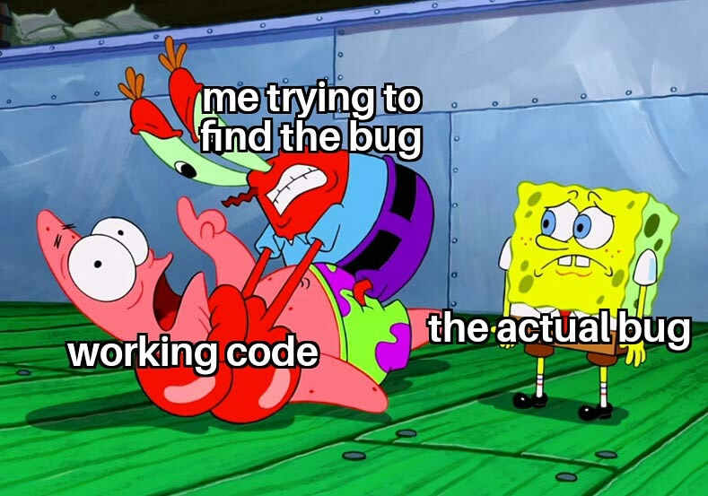
Let’s start
How I felt while preparing the workshop:
Stunned in disbelief
How to set up my computer?!?!?!?!?

